Slide 1
Neural Nets with Pytorch
Session 5: Advanced Concepts

Slide 2
Final Session
Transfer Learning
Unsupervised Learning
Custom Loss Functions
Introduction to Generative Modelling

Slide 3
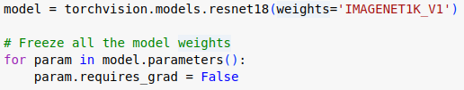
Transfer Learning
Re-use an existing neural network for your own task.
Two (general ) types:
Transfer Learning
Fine Tuning

Slide 4
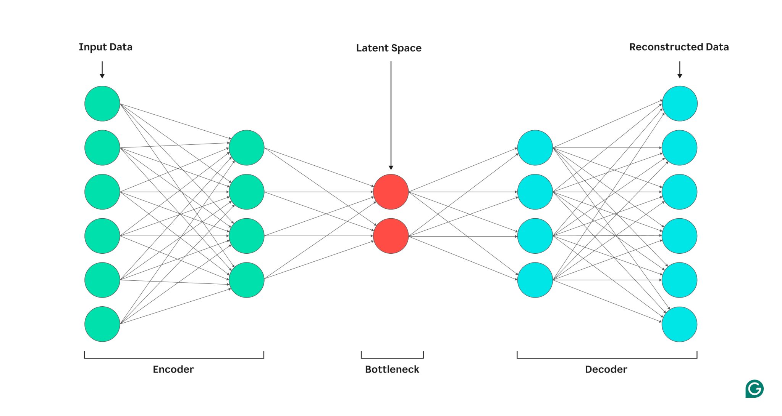
Unsupervised Learning
Learning with no labels (Autoencoder)

Slide 5
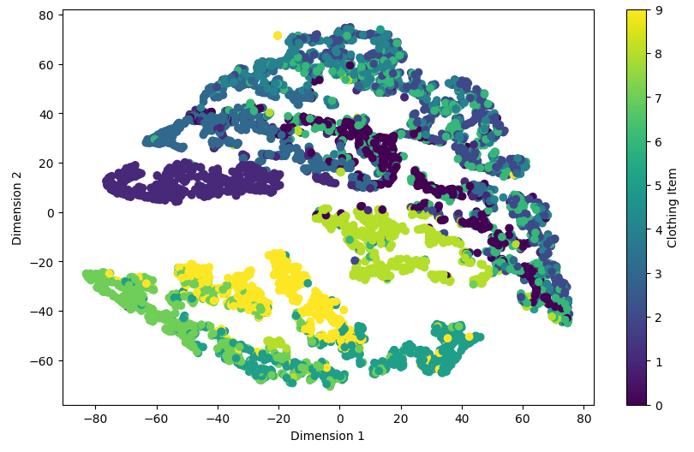
Unsupervised Learning

Slide 6
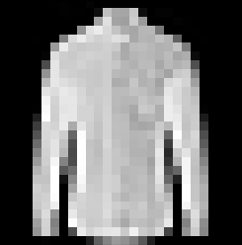
Generative Modelling
?

Slide 7
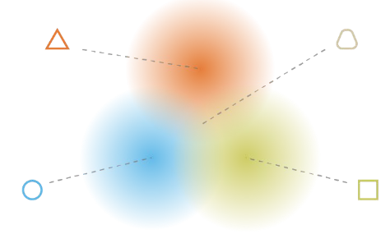
Variational Autoencoders
A more advanced autoencoder that can be used generatively
Continuous latent space

Slide 8
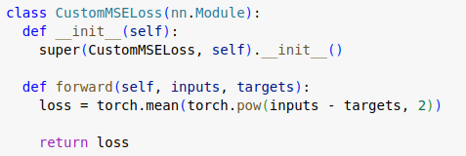
Custom Loss Functions
Control the error in your network.
Must be differentiable!

Slide 9
VAE - Loss
To train, requires a custom loss function (not a built-in)
Combines:
Reconstruction loss: Create good-looking images
KLD Loss: Force latent distribution towards normal distribution

Slide 10
Practical Worksheet

